Slide 1

Natural Language Processing: Feature Extraction’s Basics
Mina Farmanbar
Associate Professor, University of Stavanger
for engineers

Slide 2




One-hot-encoding
Words can be represented by one-hot vectors:
$$\left[\begin{matrix}1 \\ 0 \\ 0 \\ 0\end{matrix}\right]$$
$$\left[\begin{matrix}0 \\ 1 \\ 0 \\ 0\end{matrix}\right]$$
$$\left[\begin{matrix}0 \\ 0 \\ \begin{aligned}1 \\ 0\end{aligned} \\ \end{matrix}\right]$$
$$\left[\begin{matrix}0 \\ 0 \\ 0 \\ 1\end{matrix}\right]$$
Apple =
Cat =
House =
Tiger =

Slide 3
Statistical Approaches
Statistical Approaches

Slide 4
Bag of words
It represents a document as a collection or bag of words, disregarding grammar and word order and focusing solely on word frequencies.
Sentence 1: “The Cat sat on the mat”
Sentence 2: “The dog played in the park”
Vocabulary: {the, cat, sat, on, mat, dog, played, in , park}

Slide 5
Bag of words
Next, we represent each sentence as a vector where the dimensions correspond to the word in the vocabulary.
The values in the vector indicate the frequency of each word in a respective sentence.
Vocabulary: {the, cat, sat, on, mat, dog, played, in , park}
“The Cat sat on the mat”
“The dog played in the park”
Vector: [1,1,1,1,1,0,0,0,0]
Vector: [1,0,0,0,0,1,1,1,1]

Slide 6

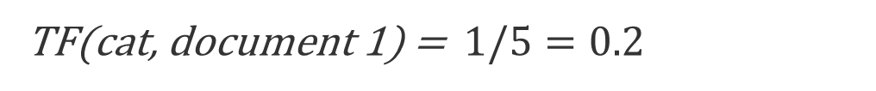
Term Frequency (TF)
Is a measure to determine the frequency of a term (word) within a document or a corpus.
TF(x,y) = $\frac{Term x frequency in document y}{Total words in document (N)}$
the | 2
cat | 1
sat | 1
on | 1
mat | 1
document 1: “The Cat sat on the mat”
TF(cat, document 1) = $1/5=0.2$
5 unique words

Slide 7
Term Frequency
documents: [“This is the first document.”, “This is the second document.” , “And this is the third one.” , “Is this the first document?” ]
Vocabulary: {And, document, first, is, one, second, the, third , this}
[0,1,1,1,0,0,1,0,1]
[0,2,0,1,0,1,1,0,1]
[1,0,0,1,1,0,1,1,1]
[0,1,1,1,0,0,1,0,1]

Slide 8
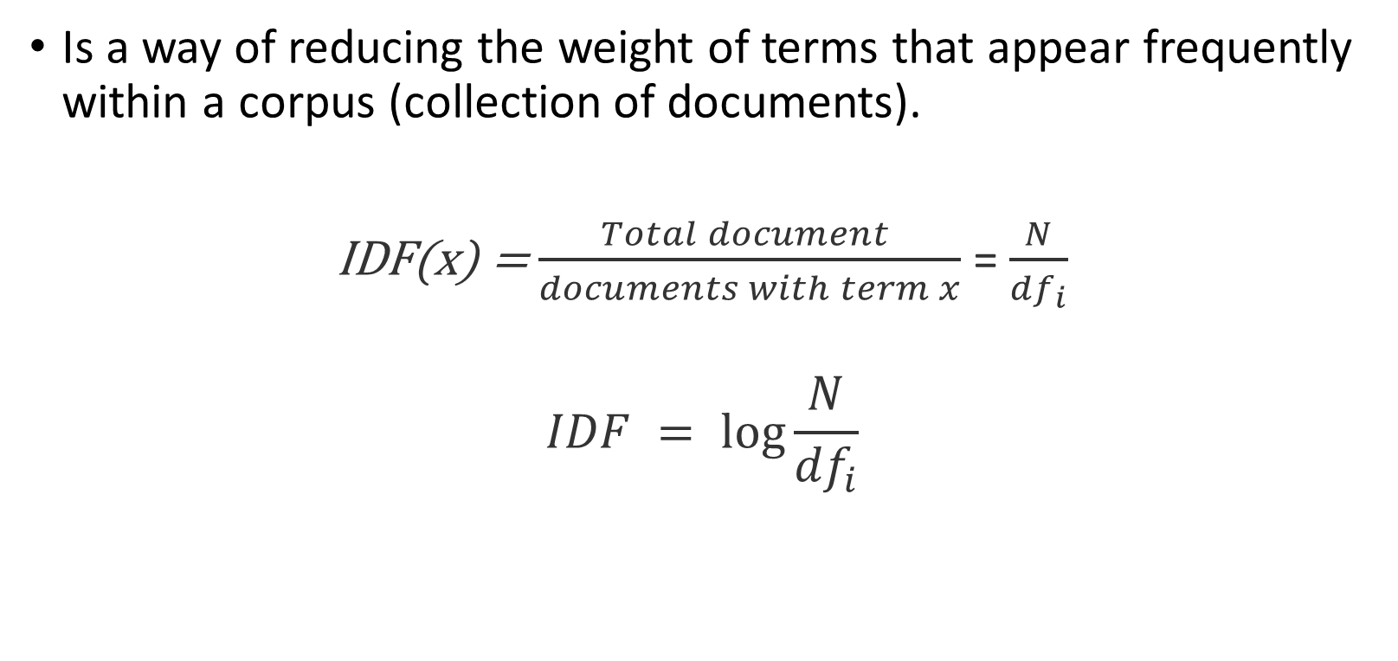
Inverse Document Frequency (IDF)
Is a way of reducing the weight of terms that appear frequently within a corpus (collection of documents).
IDF(x) = $\frac{Total document }{documents with term x}$ = $\frac{N}{{df}_{i}}$
$$IDF = \log{\frac{N}{{df}_{i}}}$$
where N is the total number of documents in your text collection and ${df}_{i}$ is the number of documents containing the term x and x is any word in your vocabulary.

Slide 9
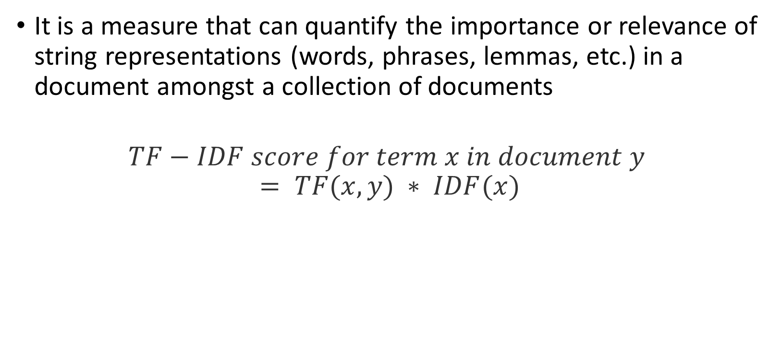
Term frequency-inverse document frequency (TF-IDF)
It is a measure that can quantify the importance or relevance of string representations (words, phrases, lemmas, etc.) in a document amongst a collection of documents
$$TF−IDF score for term x in document y = TF(x,y) ∗ IDF(x)$$

Slide 10
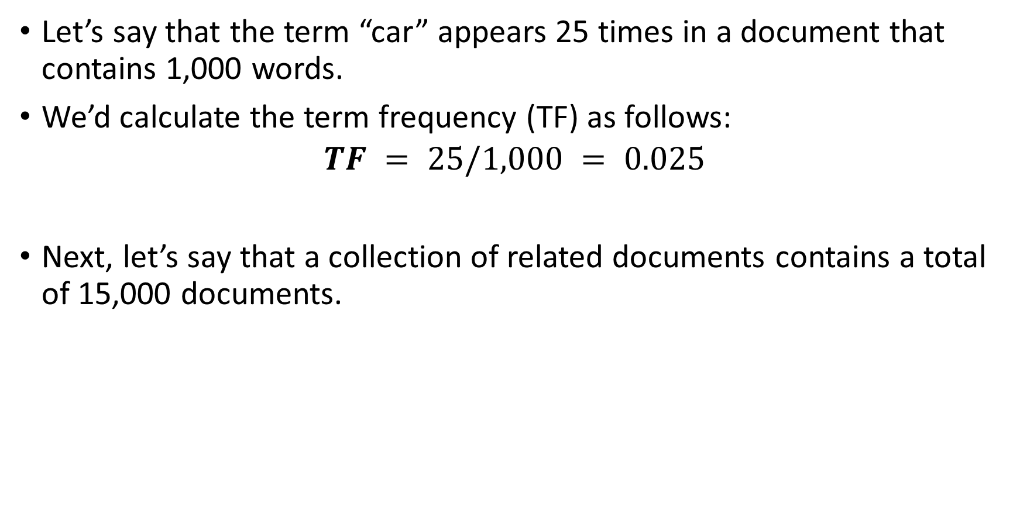
Term frequency-inverse document frequency (TF-IDF)
Let’s say that the term “car” appears 25 times in a document that contains 1,000 words.
We’d calculate the term frequency (TF) as follows:
$$TF = 25/1,000 = 0.025$$
Next, let’s say that a collection of related documents contains a total of 15,000 documents.

Slide 11
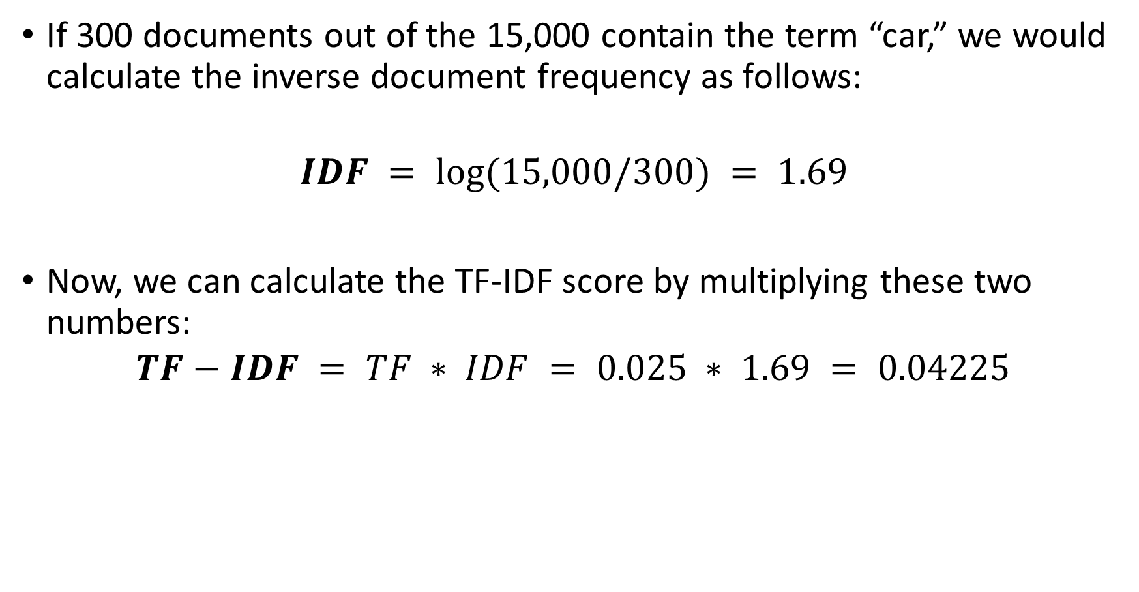
Term frequency-inverse document frequency (TF-IDF)
If 300 documents out of the 15,000 contain the term “car,” we would calculate the inverse document frequency as follows:
$$IDF = log⁡(15,000/300) = 1.69$$
Now, we can calculate the TF-IDF score by multiplying these two numbers:
$$TF−IDF = TF ∗ IDF = 0.025 ∗ 1.69 = 0.04225$$

Slide 12
Statistical Approaches
Neural Approaches

Slide 13
Word Embeddings
Maps words to high-dimensional vectors where semantically similar words are closer in the vector space.
Word2Vec
Pretrained Word-Embedding

Slide 14
Word2Vec
Is a shallow neural network model for word representation.
Converts each word in the vocabulary into a continuous vector.
Captures semantic relationships by placing similar words close together in the vector space.
Words with related meanings have similar vectors.
Input: text corpus.
Output: set of vectors.
There are two neural embedding methods for Word2Vec:
Continuous Bag of Words (CBOW)
Skip-gram.

Slide 15
Word2Vec
 | Horse | King | Man | Queen | Woman
Authority | 0.01 | 1 | 0.2 | 1 | 0.2
Has tail? | 1 | 0 | 0 | 0 | 0
Rich | 0 | 1 | 0.3 | 1 | 0.2
Gender | 1 | -1 | -1 | 1 | 1
Features
King
1
0
1
-1
Man
0.2
0
0.3
-1
Woman
0.2
0
0.2
1
??
1
0
0.9
1
-
+
=
Queen
1
0
1
1
Feature Vectors

Slide 16
Pretrained Word-Embedding
Representations learned from large corpora.
Reusable for various NLP tasks.
BERT (Bidirectional Encoder Representations from Transformers)
Transformer-based model for contextualized embeddings.
Considers both left and right contexts.
Captures rich contextual information.

Slide 17
Thank you!
Mina Farmanbar
mina.farmanbar@uis.no

